Slide 1
ITEC 101 FUNDAMENTALS OF IT
DANIEL OBUOBI, DCSIT,CU
INPUT & OUTPUT

Slide 2
INPUT DEVICES
Consists of devices that translate data etc into a form that computer can process
The purpose is to convert human-readable information into machine-readable form.
Most computers require input from a user
As the user starts typing data, it is placed in RAM and then appears on the screen.

Slide 3
TYPES OF INPUT DEVICES
2 kinds of input devices
the keyboard entry and
direct entry
Keyboard Entry (the most common)
Keyboard & KBD ergonomic
VDU (Terminal) & Terminal ergonomic
Direct Entry
create machine readable data that go directly to the Computer
Typical examples are
Pointing Devices & sensitive screen
Source Data Input Devices / Source Data Automation
Voice-input devices
Video & photographic input and sensors

Slide 4
KEYBOARD ENTRY
Similar to electric-typewriter KBD but contain additional keys.
converts letters, numbers, and other characters into electrical signals that are machine-readable.
Consists of an array of switches, each of which sends a unique signal when pressed to the PC.
The standard layout is QWERTY KBD

Slide 5
TERMINAL
Consists of a keyboard for inputting information and a monitor for receiving output.
Most popular form of data entry for on-line applications
The output display is available as long as it appears on the screen.
Data entered via terminal can be stored on disk for later use
Come in various shapes, sizes and abilities, but broadly speaking they are classified as dumb or intelligent.

Slide 6
TYPES OF TERMINAL
Dumb terminal
Passive.
Can only accept data from the KBD, relay it to the PC & receive data
It has limited storage capacity.
Intelligent terminal
Contains a processor, RAM and some internal storage.
It is a PC with communication software + link.
Can be program.
Perform the task of editing leaving the computer to concentrate on a more demanding processing activities.
Network terminal (thin client or network computer)
Low cost alternative to an intelligent terminal.
Most do not have hard drive and must rely on the host PC.
Internet terminal (web terminal)
provides access to the internet and display web pages on standard television set. Used almost exclusively at home.

Slide 7
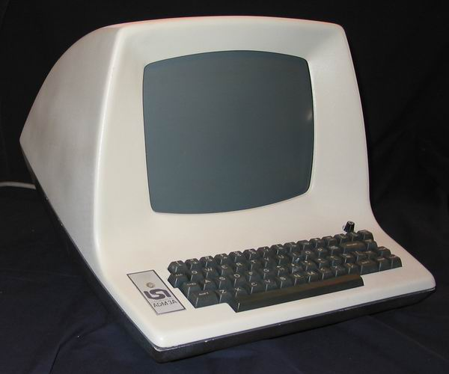
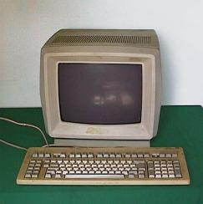
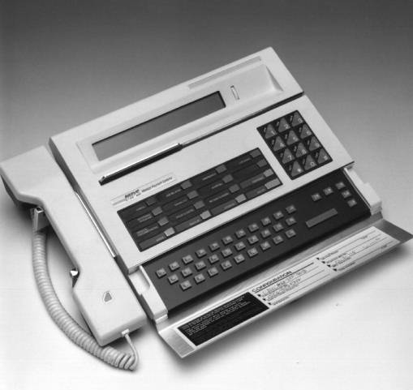
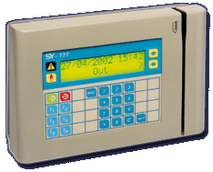
DUMP & INTELLIGENT TERMINAL

Slide 8
DIRECT ENTRY
Input does not require data to be keyed.
May create machine –readable data on paper or magnetic media or fed directly into the CPU.
Reduces the possibility of human / data entry error.
An economical means of data entry.
They are classified as pointing device, scanning device and voice-input devices.

Slide 9
POINTING DEVICES
Mouse: rolled about on a desktop to direct a pointer on the computer’s display screen.
When one moves the mouse, the pointer on the screen moves in the same direction.
Pointer - indicates the position of the mouse on the display screen.
Change from an arrow to a pointing-finger icon, based on the task being performing.
Controls the position of the cursor on the screen.
Examples include: Mice, trackballs, joysticks and touchpad, Light pens, Digitizing tablets, Pen-based systems.

Slide 10
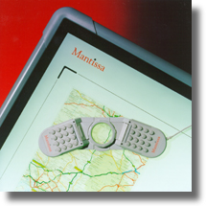
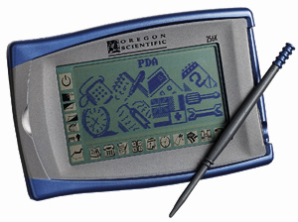
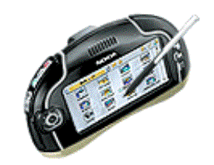
SENSITIVE SCREEN INPUTS
TOUCH SCREENS
LIGHT PENS
DIGITIZERS
Pen-based systems

Slide 11
TOUCH SCREEN
Touch Screen –monitor screen covered with plastic layer.
Behind this layer is a crisscrossed invisible infrared light.
Arrangement enables the selection of actions or command by touching the screen with a finger
When the finger touches the screen, it blocks out the lights emitted from that portion of the screen.
The screen then determines which part of the screen is touched, and therefore the selection.
Easy to use when the user needs information quickly.

Slide 12
LIGHT PEN
Light pen – is a light sensitive pen-like device.
The light pen is placed against the monitor.
This closes a photoelectric circuit and identifies the spot for entering or modifying data.
It is connected by a wire to the computer terminal.
The user brings the pen to a desired point on the display screen and presses the pen button, which identifies that screen location to the computer.
Used by engineers.

Slide 13
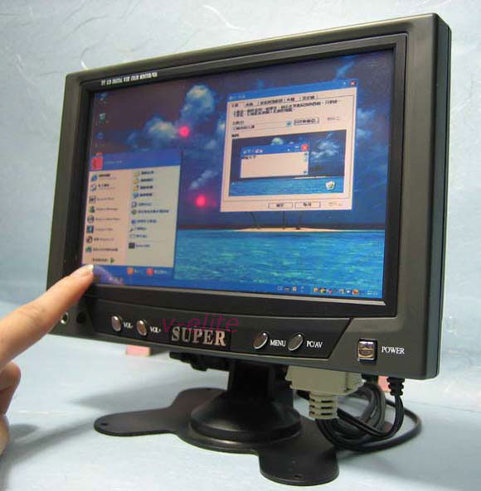
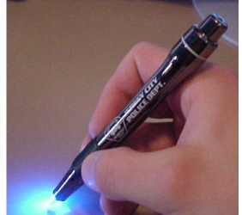
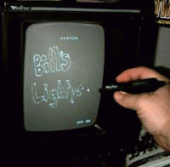
TOUCH SCREEN & LIGHT PEN

Slide 14
DIGITIZERS
Consists of a tablet connected by a wire to a stylus or puck.
A styling is a pen-like device with which the user “sketches” an image.
A puck is a copying device with which the user copies, or traces, an image.
Used with drawing and painting software, work like an artists
A puck, can trace a drawing laid on the tablet, and store a digitized copy in the computer.
Used primarily in graphic design, computer animation, and engineering

Slide 15
PEN-BASED SYSTEMS
There are four types
Handwriting stored as scribbling: recognizes and stores handwriting.
The handwriting is stored as a scribble and is not converted to type text.
Handwriting converted, with training, to typed text: can recognize handwriting and transform it into typed text.
Machine must be “trained” to recognize your particular (or even peculiar) handwriting. ( the writing must be neat printing).
The advantage of converting writing to typed text is that after conversion the text can be retrieved and later edited or further manipulated.
Handwriting converted, without training, to typed text: The most sophisticated-and still mostly elusive- application of pen-based computers
converts script handwriting to typed text without training.
Small handheld computers, called PDAs use pen-based input.
Larger PDAs have small KBD. Smaller PDA use pen-based input
Popular palm computers include 3COM’s PalmPilot and Palm III.

Slide 16
SOURCE DATA INPUT DEVICES
Do not require keystrokes to input data to the computer.
Data is entered from as close to the source as possible.
Most common source-data entry devices is the scanner.
An advantage – KBD errors are almost eliminated.

Slide 17
SCANNING DEVICES
use laser beams and reflected light to translate hardcopy images of text, drawings, photos, and the like into digital form.
The images can then be processed by a computer, displayed on a monitor, store on a storage device, or communicated to another computer.
Scanning devices include:
Image scanner, fax machines, Bar-code readers, mark- and character-recognition devices.

Slide 18
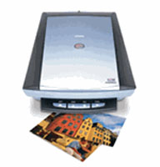
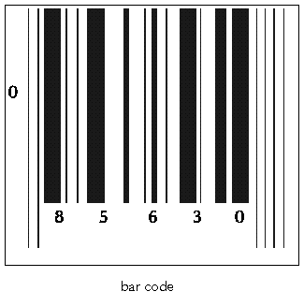
TYPE OF SCANNING DEVICES
Scanning Devices
Image Scanners
Fax Machines
Bar-Code Readers:
Point of sale terminal (pos):
Mark-Recognition & Character-Recognition Devices
MICR
OCR
OMR

Slide 19
Image Scanners, Fax, Bar code
Image Scanners
converts text, drawings, and photographs into digital form that can be stored manipulated.
flatbed, drum, or handheld.
Fax Machine
scans an image on paper and sends it as electronic signals over telephone lines to a receiving fax machine,
Bar Code
photoelectric scanners that read the bar codes printed on most manufactured product containers.
Using a laser scanner, the beam passes over the code noting the occasion when a bar reflects lights and when a space absorbed lights.

Slide 20
POINT OF SALES TERMINAL
Widely used in the banking and retail industries.
The price of a particular item is retrieved from the main computer and appears on the salesclerk’s point-of-sale (POS) terminal and on your receipt.
Records of sales used for accounting, restocking store inventory, and weeding out products that don’t sell well.
The information makes them useful for analyzing the movement of items and determining what happens to them during production

Slide 21
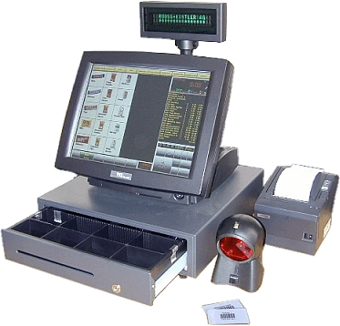
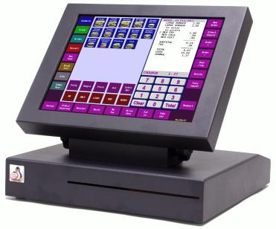
POS SYSTEM

Slide 22
HOW POS WORKS
Customer number is entered on the terminal
Number used to retrieve customer credit remaining
The terminal read the bar code / tag on the item.
Item code used to retrieve price.
Price compared with the customer remaining credit if the purchase can be allowed.
If it is allowed, the following occur:
The terminal prints the receipt
The price of the item is added to the amount the customer owes
The price is subtracted from the remaining credit
The quantity of the item bought is updated.

Slide 23
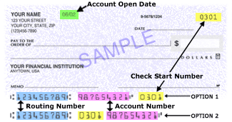
OPTICAL INPUT DEVICES
There are three kinds of scanning devices that translate certain types of marks and characters.
They are usually referred to by their abbreviations
MICR,
OMR, and
OCR.

Slide 24
MICR
Magnetic-ink character recognition (MICR)
Used mainly in the banking industry to process cheques.
The bottom portion of a typical cheque contains characters preprinted using special ink such as:
identifying the bank,
account number,
and cheques number.
The characters are magnetized as the cheques pass through the reader, which electronically reads the magnetized characters.
With this, a scanner translates the magnetically charged numbers printed at the bottom of bank cheques / deposit slips.

Slide 25
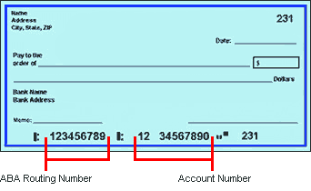
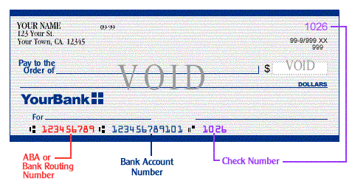
MICR

Slide 26
OMR
Optical mark recognition (OMR)
Also called marking sensing.
Senses the presence or absence of a mark such as pencil mark.
Reads pencil marks and converts them into computer-usable form.
Technology is used scoring of the multiple-choice tests for WAEC, Scholastic Aptitude test (SAT), Graduate Record Examination (GRE), and so on. Accuracy depends on the solid mark.

Slide 27
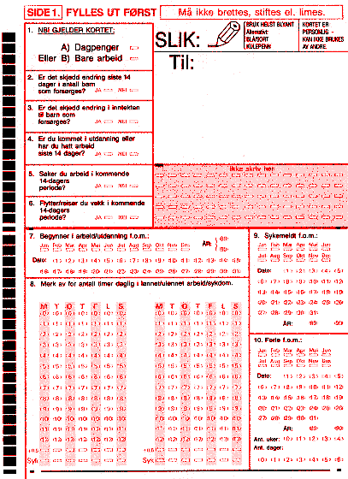
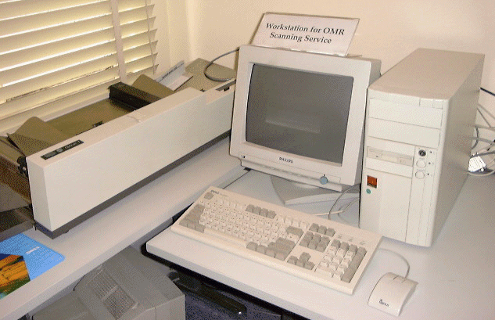
OMR

Slide 28
OCR
Optical character recognition (OCR):
Reads OCR fonts, typewriter and computer-printed characters, and converts them into machine-readable form.
Used for utility bills & price tags on department-store merchandise.
More sophisticated than OMR in that they can distinguish one character from another using the shape.
Some advanced OCR systems can recognize human handwriting.
Using OCR can be 5 times faster than retyping a document into the computer.
The important function of OCR is that, once the text appears on-screen, a user can copy it to a word processing program, spell checks it, make corrections and additions, and save it.
Can read up to 10,000 A4 documents per hour.

Slide 29
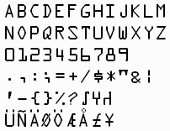
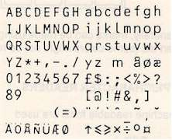
OCR FONTS
OCR FONT A
OCR FONT B

Slide 30
VOICE INPUT DEVICE
To the computer, speech recognition is extremely complicated due to:
vast differences in human speech.
different ways of saying exactly the same thing
different languages, different dialects, pronunciations, and accents within the same language, different sounds, within each dialect
The speech of the same person sounding differently on different days because they might have a cold or in different modes
Natural languages such as English, for example, are context sensitive.

Slide 31
VOICE-INPUT
Accept spoken commands and convert them into electronic pulses, which can be processed by the computer.
Limited by the vocabulary they can understand.
Most widely used voice-input device is the microphone.
This device combined with a sound card and appropriate software, forms a voice-recognition systems.
A voice-recognition system, using a MIC (or phone) as input device, converts speech into digital code by comparing the electrical patterns produced with a set of pre-recorded patterns stored in the computer.
More advanced software can recognize the same word spoken by different people

Slide 32
VIDEO & PHOTOGRAPHIC INPUT
Most film & videotape must be converted to digital form through a special video capture, or digitizing card installed in the computer.
Video Cameras (analog and digital video cameras)
Analog video cameras convert light intensities into analog signals, digital video cameras convert it into discrete 0s and 1s.
Digital Camera
A digital camera captures images in electronic form for immediate viewing on a television or monitor.
Uses a light-sensitive processor chip to capture photographic images in digital form on a memory card inserted in the camera
Sensors
A sensor is a type of input device that collects specific kinds of data directly from the environment and transmits it to a computer.

Slide 33
OUTPUT DEVICES
Consists of devices that translate data etc into a form that human can read
The purpose is to convert machine-readable information into human-readable form.
Most user require output from a PC
The output from the processing is sent to the user.

Slide 34
CATEGORY OF OUTPUT
2 broad categories:
Human-readable output, serving information needs of the people
Machine-readable output, which is used subsequently as input to the computer
Output comes in many forms such as
Payroll generation, Billing, Statistical or text form
Displaying of graphically information, text etc
Recording in microfilm,
Recording as a voice response
Storing of information on disk or tape for future reporting.

Slide 35
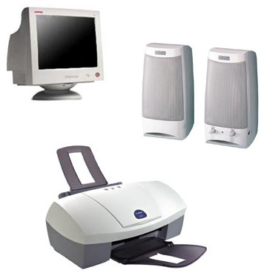
COMMON OUTPUT DEVICES
Printers (impact & non impact printers)
Graph Plotters
Computer output on microfilm (COM)
Audio response Unit (ARU) / Audio output H/W
Visual Display Unit (VDU) (CRT, Flat Panel)
Sound Output

Slide 36
PRINTERS
Categorized according to
impact printers or non-impact printers
Within these categories, they’re a large variation in speed and quality.
Speed of operation largely dependent on whether the it produces
a character, a line or a page of print at a time.
Hence we have also
character‑printer ,
line-printers or serial-printers,
Page Printers.

Slide 37
IMPACT PRINTERS
Mechanisms resembling the typewriter
Forms characters or images by striking using a print hammer or wheel against an inked ribbon, leaving an image on paper.
Quality and style can be selected through a keypad on the casing.
Are noisy, inexpensive, but can print multiple copies
Used when high quality is not essential eg circulating information

Slide 38
LINE PRINTERS
There 2 main types - Band and Chain Printers
High-speed printers usually used in the minicomputers and mainframes environment.
Called high-speed printer because they print a whole line of characters at once rather than a single character
Print quality is good. Speeds of up to 3000 lines a minute may be possible with these machines.
The band printer has a flexible rotating steel band that contains the characters used for the printing.
The chain printer also has a rotating chain that contains the characters to be printed.

Slide 39
FEED MECHANISM
Two types of feed mechanism – friction and tractor feed mechanism.
Friction Feed Mechanism
Paper is gripped by the roller.
It moves through the friction feed printer by pressure on the paper and the carriage.
As the carriage rotates, the paper is transported through the printer.
Tractor feed Mechanism
Paper is held in place by a tractor.
This reduces the chance of the paper getting out of alignment.
Sprocket (a mechanism) that advances the paper, using holes on the edges of continuous form.

Slide 40
NON-IMPACT PRINTERS
Used almost everywhere.
They are faster and quieter because they have fewer moving parts.
Form characters and images without direct physical contact between the printing mechanism and the paper.
Two types of non-impact printers often used with PC are
laser printers and
ink-jet printers.

Slide 41
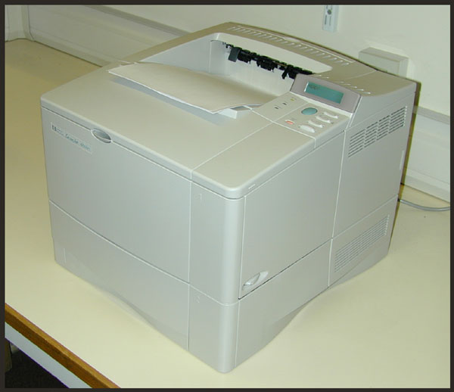
LASER PRINTER
Uses a combination of two technologies – electro photographic printing (used in photocopy) and high intensity lasers.
Reasons why laser printers are popular.
They produce sharp, crisp images of both text and graphics,
providing resolutions which is near-typeset quality (NTQ).
They are quiet and fast.

Slide 42
HOW LASER PRINTER WORKS
Image from PC is transferred to the printer.
A microprocessor inside the printer converts the image line by line into a sequence of signals, which switch a laser beams on and off.
Each laser bean pulse (a single dot of the image), is reflected by a rotating mirror to the surface of the drum.
Drum surface given an electrical charge whenever the beam strikes.
Each line of image transferred to the drum, rotates the drum
As the drum rotates, it comes in contact with the toner (plastics ink powder), which is attracted, to the electrically charged area of the drum.
Charge on paper > charge on drum, so the toner is transferred to the paper.
Toner permanently bonded to the paper by heated rollers.

Slide 43
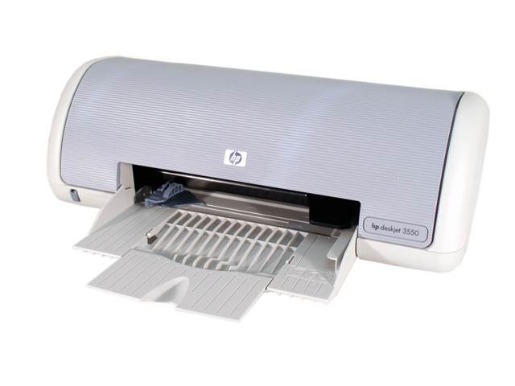
INK JET PRINTERS
Form images with little dots.
Head consists of ink jets arranged in a matrix
Spray small, electrically charged droplets of ink from nozzles (through holes in the matrix) at high speed onto paper
Can print in colour
Are quieter less expensive

Slide 44
BUBBLE-JET & SOLID INK PRINTERS
Bubble-jet printers
Variation on ink-jet technology
Uses miniature heating elements to force specially formulated inks through print heads with 128 tiny nozzles
print fine images at high speeds.
This technology is commonly used in portable printers.
Solid ink printers:
They are page printers that use solid wax ink sticks (which are crayon-like ink).
Use heat to liquefy the wax ink sticks into reservoirs,
Then spray the molten ink onto a transfer drum, from where it's cold-fused onto the paper in a single pass.

Slide 45
THERMAL & PHOTOGRAPHIC PRINTERS
Thermal Printer
Uses heat sensitive paper.
Characters printed by applying heat to selected rods in the print head.
When the heated rods touch the paper, the character is formed.
It is originally used in scientific labs to record data
Use to produced high quality colour artwork and text.
not popular because of cost and used of specially treated paper.
Photographic Printers:
can produced high-quality output on photographic film or paper, using photographic techniques.

Slide 46
PLOTTERS
Specialized device designed to produce high-quality graphic e.g. maps, drawings and 3-D illustration
The two principal kinds of plotters are ink-jet and electrostatic
Ink-jet plotter: less expensive and slower than the electrostatic plotters. It uses ink-jets technology
Pen Plotters: creates plots by moving a pen over drafting paper. With some the paper moves and the pen remain stationary.

Slide 47
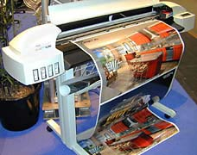
INK-JET & PEN PLOTTERS
Ink-jet plotter
Less expensive & slower than electrostatic plotters.
Uses ink-jets technology and the paper is output over a drum, enabling continuous output.
Pen Plotters
Creates plots by moving a pen over drafting paper.
With some the paper moves and the pen remain stationary.
Less expensive & easier to maintain.
Slow speed
Can’t produce solid fills / shadowing.

Slide 48
ELETROSTATIC & THERMAL PLOTERS
Electrostatic plotter
Designed so that the paper lies partially flat on a table-like surface.
Use toner in a manner similar to a photocopier.
Use electrostatic charges to create images made from tiny dots on specially treated paper.
Image is produced when the paper run through a developer.
Produce high-resolution images and are faster than inkjet and pen plotters.
Used in advertising and graphic design.
Thermal Plotters / Direct Image Plotters:
creates image using heat sensitive paper and electrically heated pins.
It is comparably priced with electrostatics printed, quite reliable, and good for high-volume work.
Require expensive paper and create only two colours.
Used for very specific application such as creating maps.

Slide 49
COMPUTER OUTPUT ON MICROFILM
This method of storing computer output uses several devices.
Output is stored as microscopic filmed images
on a roll of microfilm or
on microfiche (rectangular sheet of film 10mm x 15mm).
A typical microfiche can hold 300 pages of printed paper. More sophisticated system can hold up to 1000 pages.

Slide 50
HOW COM WORKS
The COM process is as follows:
The computer writes the output to magnetic tape
The data on tape is input to the microfilm recorder and
the recorder display the output on the monitor.
Using microfilm a high speed camera photographs the images on the monitor.
The film is then developed
Duplicates are then made, if necessary

Slide 51
COM EQUIPMENTS
In some system,
a separate device is needed for each of these stages.
others the tape drive is not needed because the computer sends the output directly to the microfilm recorder.
Some recorders are capable of developing the film so a developer is not needed.
To view the film,
a microfilm viewing station is used.
This magnifies the film so that they can be easily read. The station usually has a printer connected to produce hard copy.
COM suited for applications where:
Volume of output is great (100,000 pages / month)
Data must be stored for a long period with infrequent references to it (archival data)

Slide 52
MONITORS
Run under the control of a graphics display adapter card
The adapter allows information to leave the computer and appear on the monitor.
In multimedia applications, a graphics coprocessor, is required
The display adapter has its own RAM, called VRAM, or video RAM.
VRAM controls the resolution of images as well as the number of colours and the speed at which the images are displayed

Slide 53
MONITOR SCREEN SIZE
The size of a screen is measured diagonally from corner to corner in inches just like television screens.
PC screen’s size are between 14 to 21 inches but 15in screens are common.
People in desktop publishing and multimedia production often use larger screens in order to view two facing pages at the same time.
Near the display screen are control knobs that, at on a television set, allow you to adjust brightness and contrast

Slide 54
TECHNOLOGY FOR MONITORS
Cathode-Ray Tubes (CRTs)
The (CRT) is a vacuum tube used as a display screen in a computer or video display terminal.
CRT’s screen display is made up of small picture elements (dots) called pixels.
A pixel is the smaller unit on the screen that can be turned on or off or made different shades.
A stream of bits defining the image is sent from the computer to the CRT’s electron gun, where electrons are activated according to the bit patterns.
The front of the CRT screen is coated inside with phosphor.
When a beam of electrons from the electron gun (deflected through a yoke) hits the phosphor, it lights up selected pixels to generate an image on the screen.

Slide 55
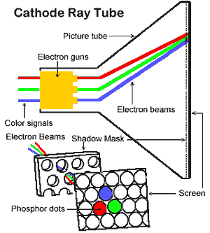
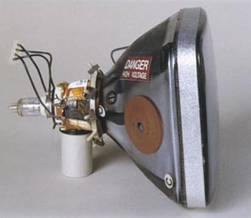
THE CRT

Slide 56
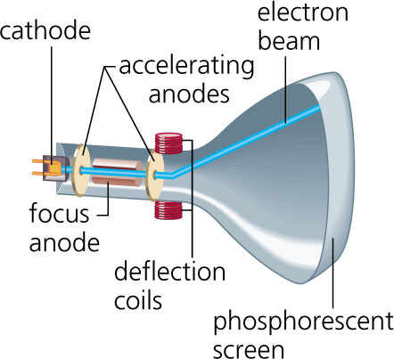
INSIDE THE CRT

Slide 57
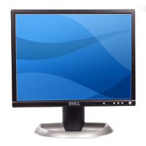
FLAT SCREEN
Used by lightweight notebooks and pocket PCs. Compared to CRTs, flat-panel displays are much thinner, lightweight, and consume less power.
The substances between the plates are either
liquid-crystal display (LCD) or
electroluminescent (EL)
According to the location of transistors flat-panel screens are
either active-matrix or
dual-scan displays:

Slide 58
LCD & EL
LCD
consists liquid crystal, the molecules of which line up in a particular way.
Under an applied voltage, the molecular alignment is disturbed, which changes the optical properties of the liquid crystal in the affected area.
As a result, light usually back lighting behind the screen is blocked or allowed through to create an image.
EL
contains a substance that glows when it is charged by an electric current.
A pixel is formed on the screen when current is sent to the intersection of the appropriate row and column.
The combined voltages from the row and column cause the screen to glow at that point.

Slide 59
ACTIVE MATRIX DISPLAY
Also called thin-film transistor (TFT) display, or TFT LCD.
Made from a large array of liquid crystal cell with one cell per pixel.
Each pixel on the screen is has TFT.
Voltage applied selectively to these cells produces the viewable image.
Much brighter and sharper than dual-scan screens.
Viewable from wider angles than images produced by most dual-scan screens, which is difficult to view from any angle other than straight on.
More complicated and thus more expensive.

Slide 60
DUAL SCAN
Also called passive-matrix display.
The LCD is made from a large array of liquid crystal cells that are controlled by transistors outside of the display screen.
One transistor controls a whole row or column of pixels.
They have good contrast for monochrome (one-colour) screens but the resolution is weaker for colour screen.
Advantage : less expensive and use less power than active-matrix displays.

Slide 61
SCREEN CLARITY
The clarity of screen depends on three qualities: resolution, dot pitch and refresh rate.
Resolution: This is the fineness of detail attained by a monitor.
it is a measure of the clarity or sharpness of a display screen;
the more pixels there are per square inch, the better the resolution.
Also the higher a resolution, the clearer and shaper the screen.
Resolution is expressed in terms of the formula columns of pixels × rows of pixels

Slide 62
DOT PITCH & REFRESH RATE
Dot pitch: This is the amount of space between pixels; the closer the dots, the crisper the image.
dot pitch is the size of the smallest dot a monitor can display.
A .28 dot pitch means dots are 28/100ths of a millimetre apart. Generally, a dot pitch of less than .31 will provide clear images.
A display’s dot pitch is an integral part the monitor’s design and so cannot be altered.
Multimedia and desktop publishing users typically use .25 mm dot pitch monitors.
Refresh rate: Refresh rate is the number of times per second that the pixels are recharged so their glow remains bright.
Refresh is necessary because the phosphors hold their glow for just a fraction of a second.
The higher the refresh rate, the more solid the image looks on the screen that is, it doesn’t flicker.
The refresh rate should be at least 72 Hz (Hertz).

Slide 63
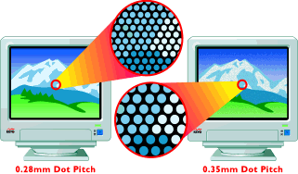
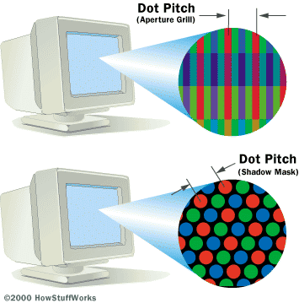
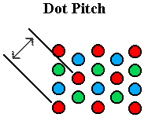

Slide 64
NOW

